Slide 1
Final project: Hwaeun(画音)
CTP 431
Gyu Huh & Jiaxian Ji

Slide 2
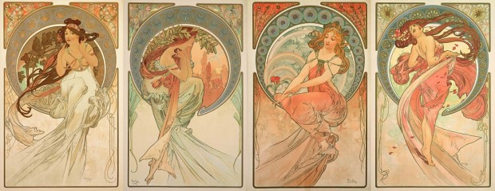
Concept
Arts be like:
Music
Poetry
Painting
Dance
Alphons Mucha, “The arts (series)”
“Can painting change into the music? (in quantitative way, bc here’s KAIST)

Slide 3
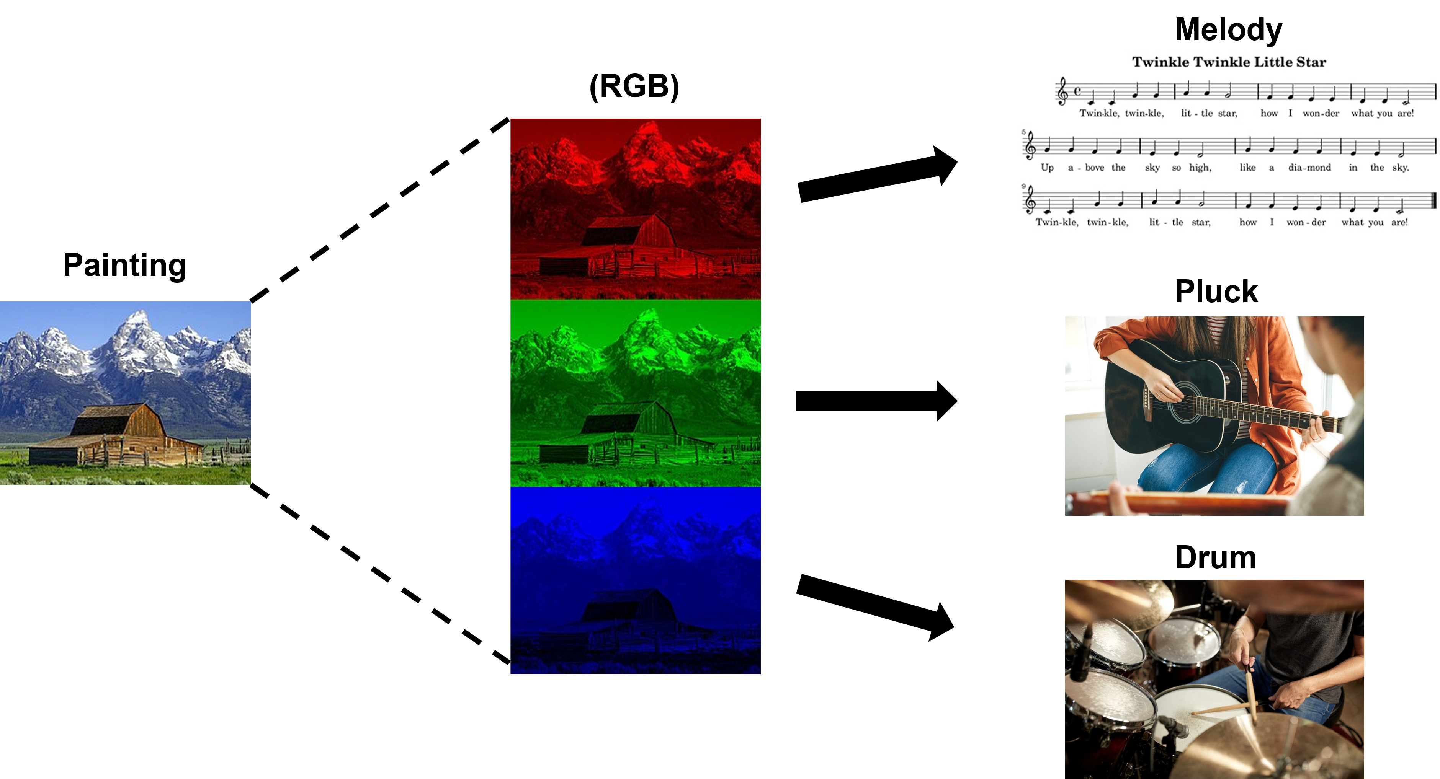
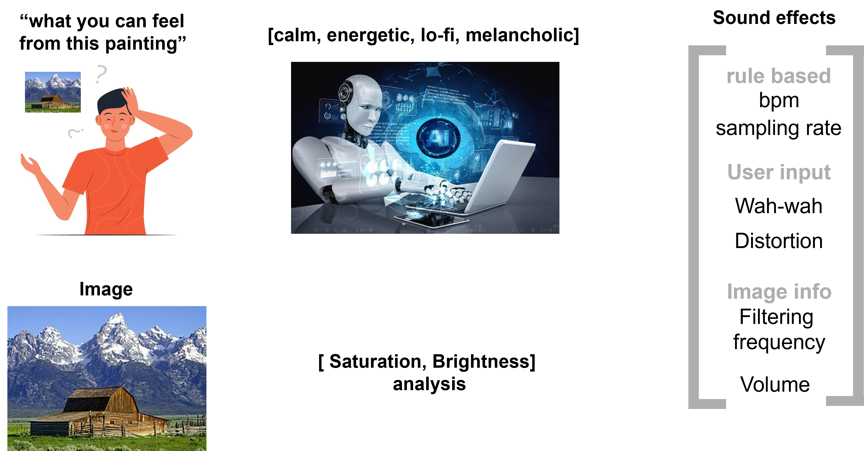
Method
Music Generation
Sound Effect

Slide 4
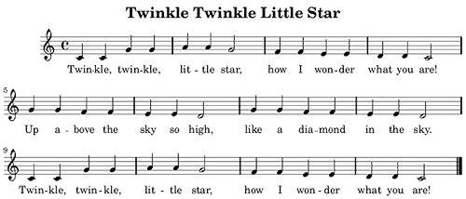
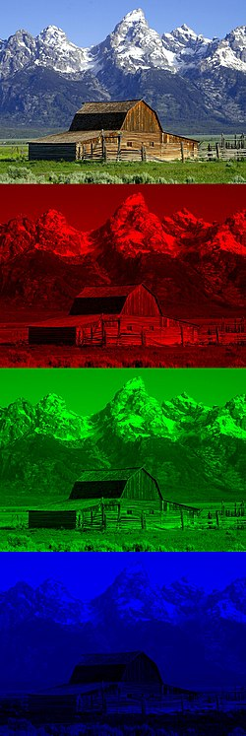
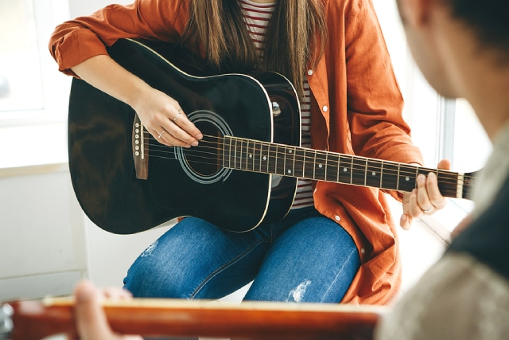
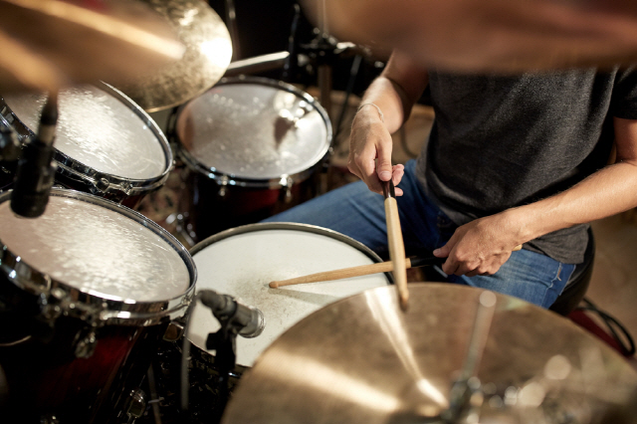
Music generation
Melody
(RGB)
Painting
Pluck
Drum

Slide 5
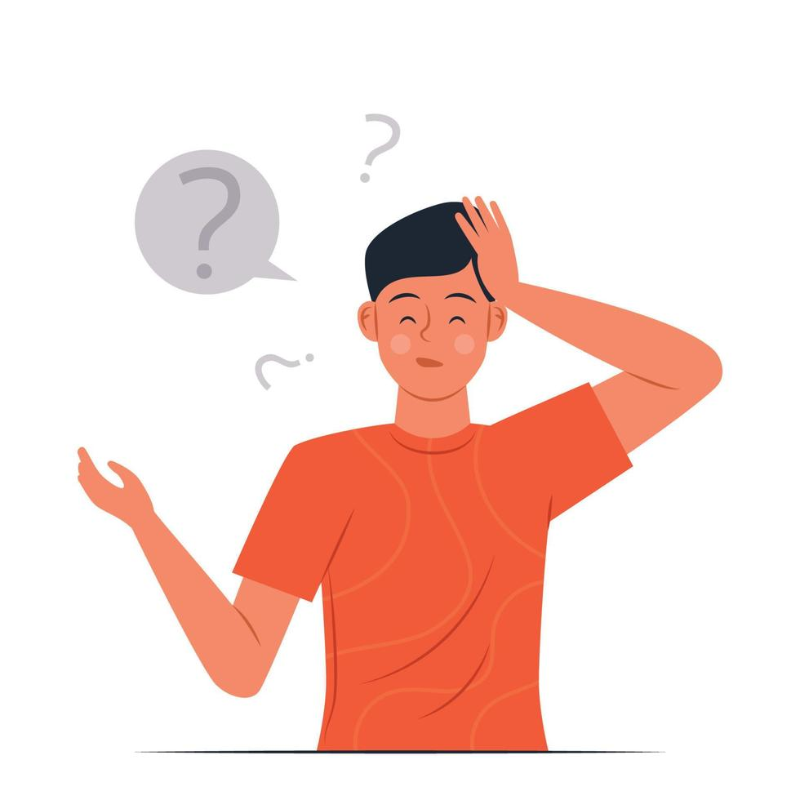

Music effect
“what you can feel from this painting”
Sound effects
[calm, energetic, lo-fi, melancholic]
rule based
bpm
sampling rate
User input
Wah-wah
Distortion
Image
Image info
Filtering frequency
[ Saturation, Brightness] analysis
Volume

Slide 6
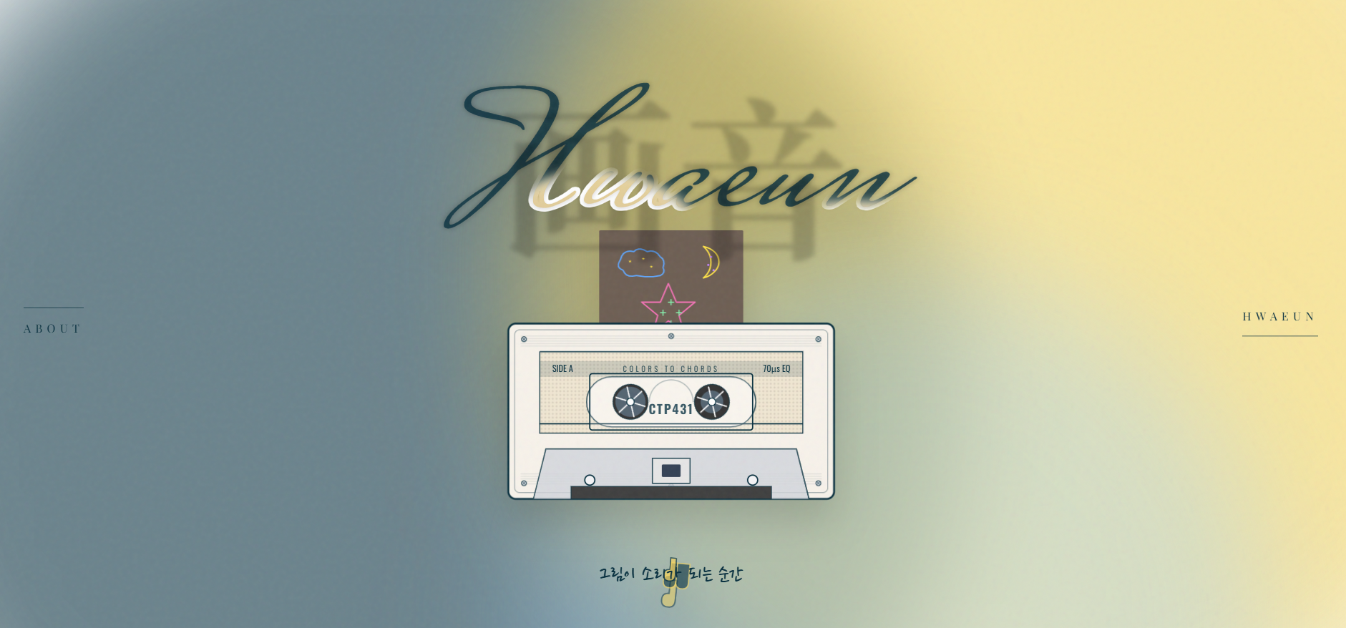
Test
There are many specific points, but there’s little time....
Let’s try!
http://13.124.69.164/

